Slide 1
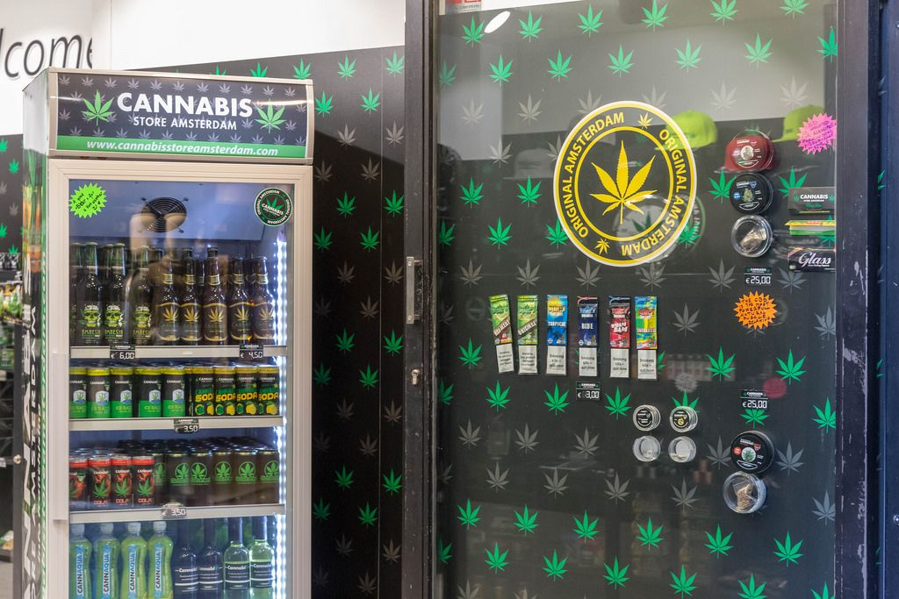
PREDICTIVE ANALYTICS FOR
CANNBIS STORE LOCATION PLANNING
Group 7
Sunil Shrestha: 133240226
Shilpa Shukla: 142280221
Asif Raja: 142487222
Sujan Panthi: 105006225
This Photo by Unknown Author is licensed under CC BY

Slide 2
INTRODUCTION
As the legal environment evolves, cannabis stores encounter distinct challenges in selecting the most suitable locations for their businesses. Predictive analytics plays a crucial role in this process. By leveraging data analysis and data-driven decision-making, cannabis stores can enhance their operations and boost profitability.
In this presentation, we will delve into the concept of predictive analytics, its application in making data-driven decisions for cannabis stores, and the specific datasets and models utilized in our analysis. Additionally, we will share the outcomes of our geographical analysis and illustrate how the predictive model can guide informed decisions regarding cannabis store locations.
3

Slide 3

GOAL & DATA SOURCES
Objective
The objective of this project is to maximize return on investment and leverage data-driven insights to determine the ideal site for a new cannabis store using predictive analytics. The investigation will concentrate on certain geographic regions and datasets pertaining to local laws, competition, and demography.
Data Sources
Data source includes Census data for targeted areas that include population data, density data, age, income and education level.
Analysis of competitor that includes the number of existing cannabis stores, their locations, and their market share.
Regulatory requirements and restrictions for cannabis stores in the targeted areas.
5

Slide 4

METHODOLOGY
Performance indicators, including as accuracy, precision, recall, and F1 score, are used to evaluate and choose models.
Recommendation of location based on ROI analysis and model findings.
Gathering and preparing data to guarantee precision and coherence.
To determine which variables are most pertinent to the analysis, use feature engineering and selection.
Regression, clustering, and decision trees are examples of machine learning techniques used in model training and validation.
6

Slide 5
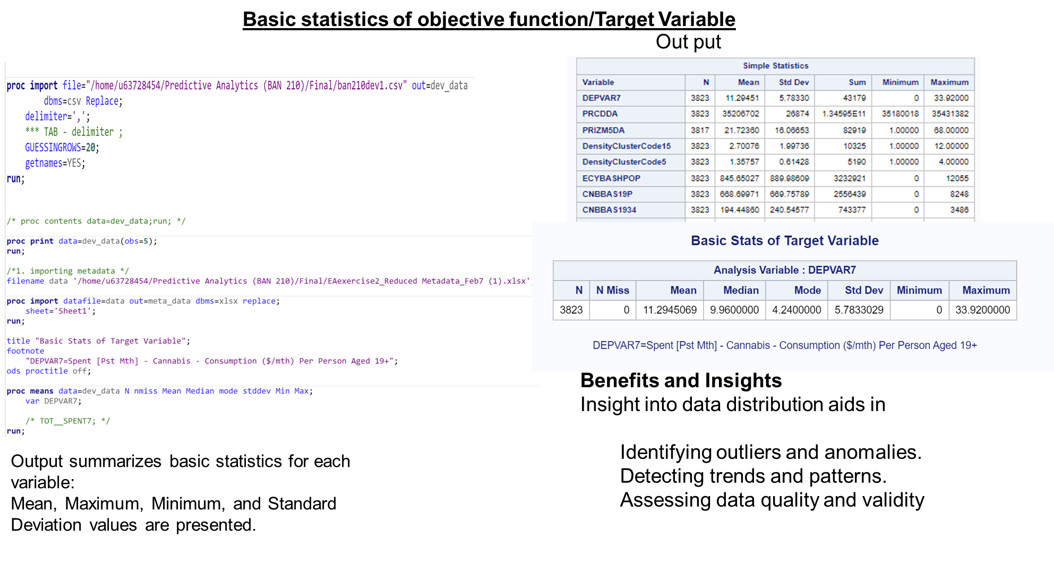
STEP 2:

Slide 6
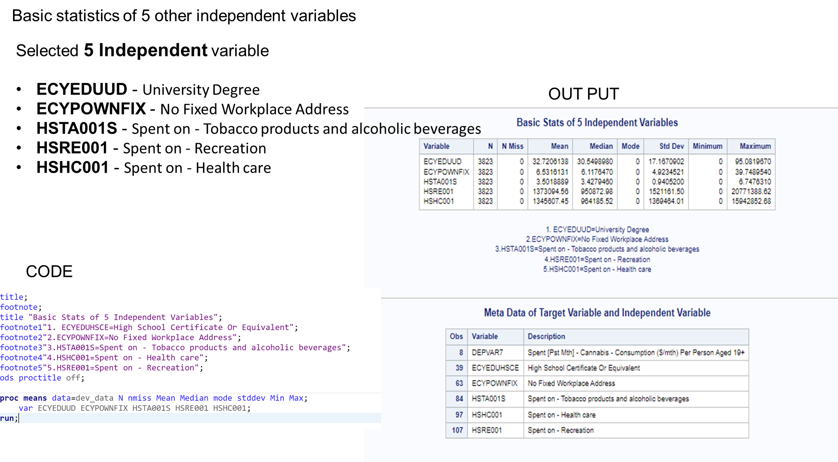

Slide 7
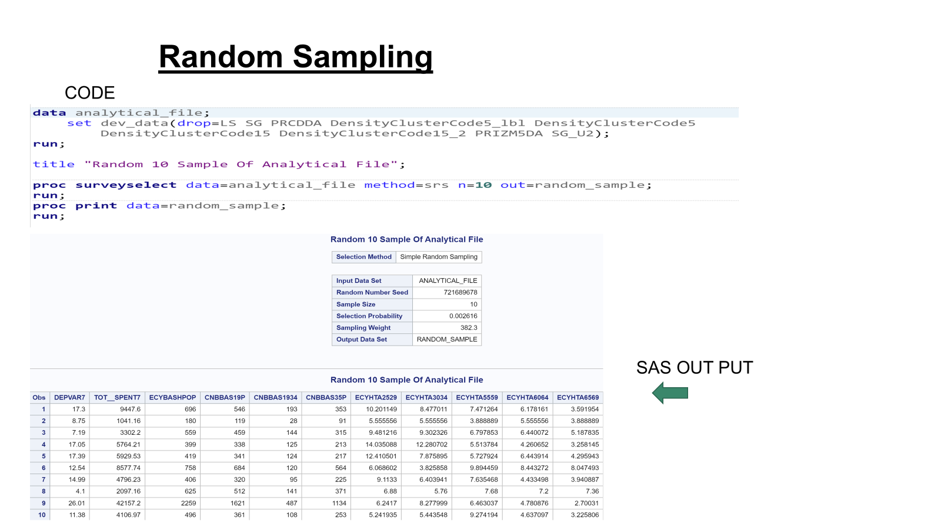
STEP 3:

Slide 8
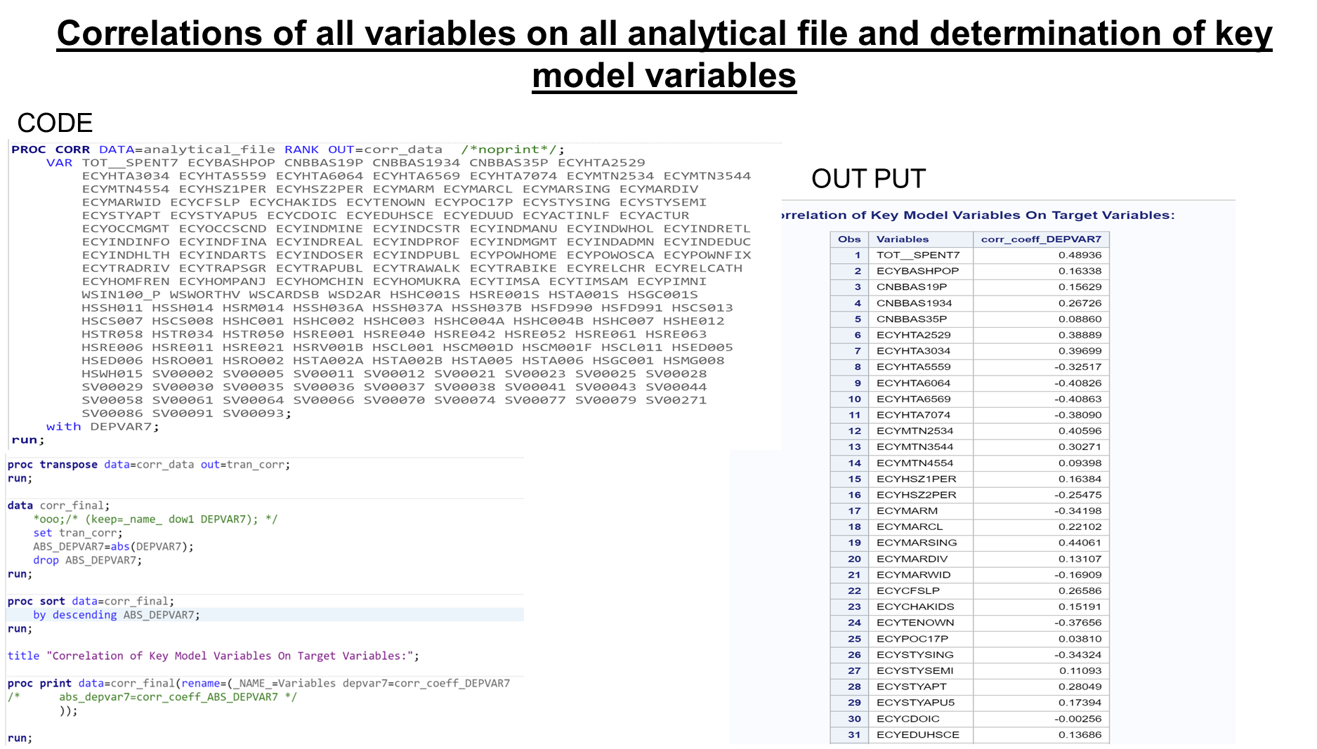
STEP 4:

Slide 9
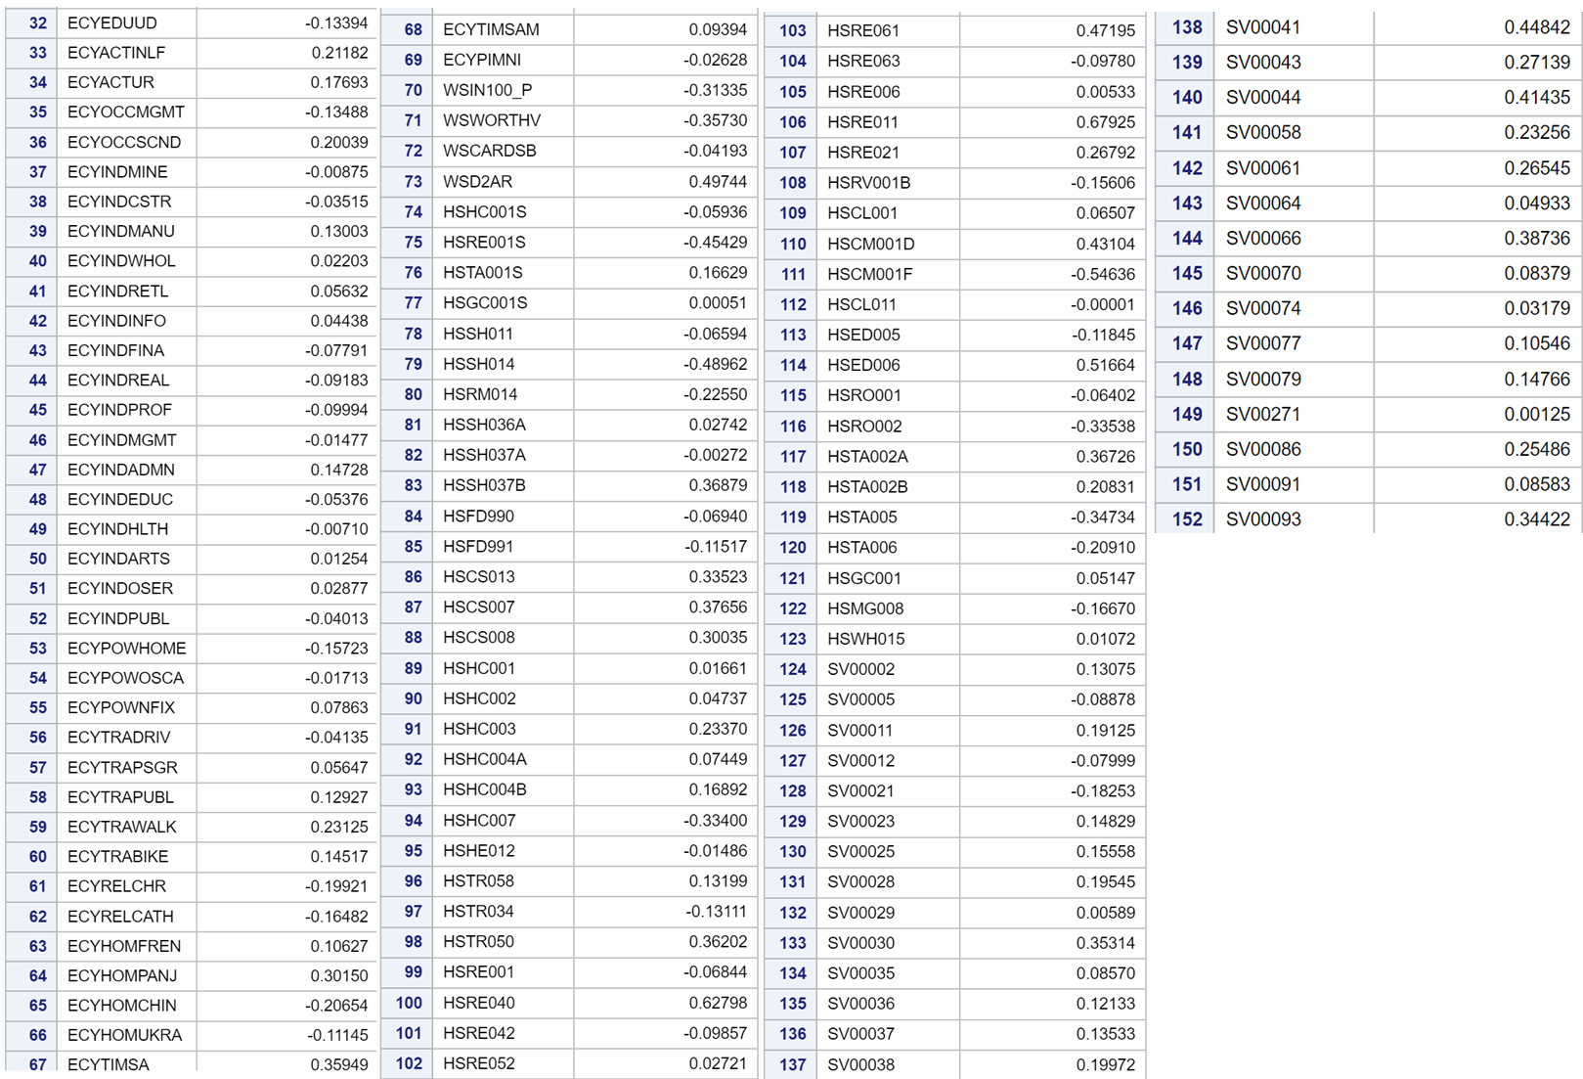

Slide 10
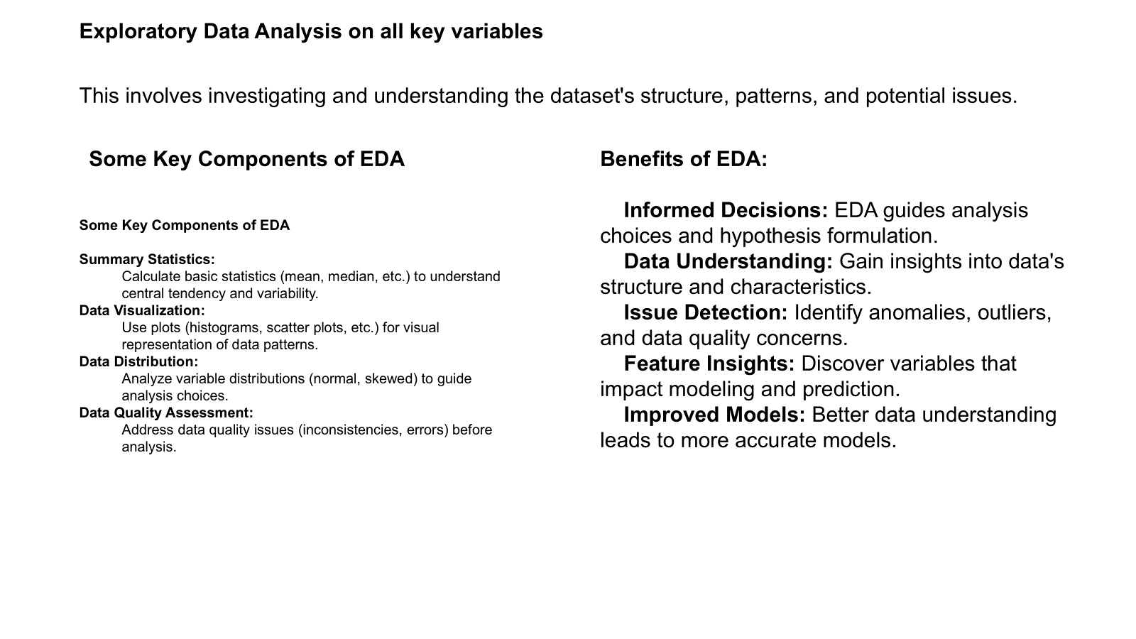
STEP 5:

Slide 11
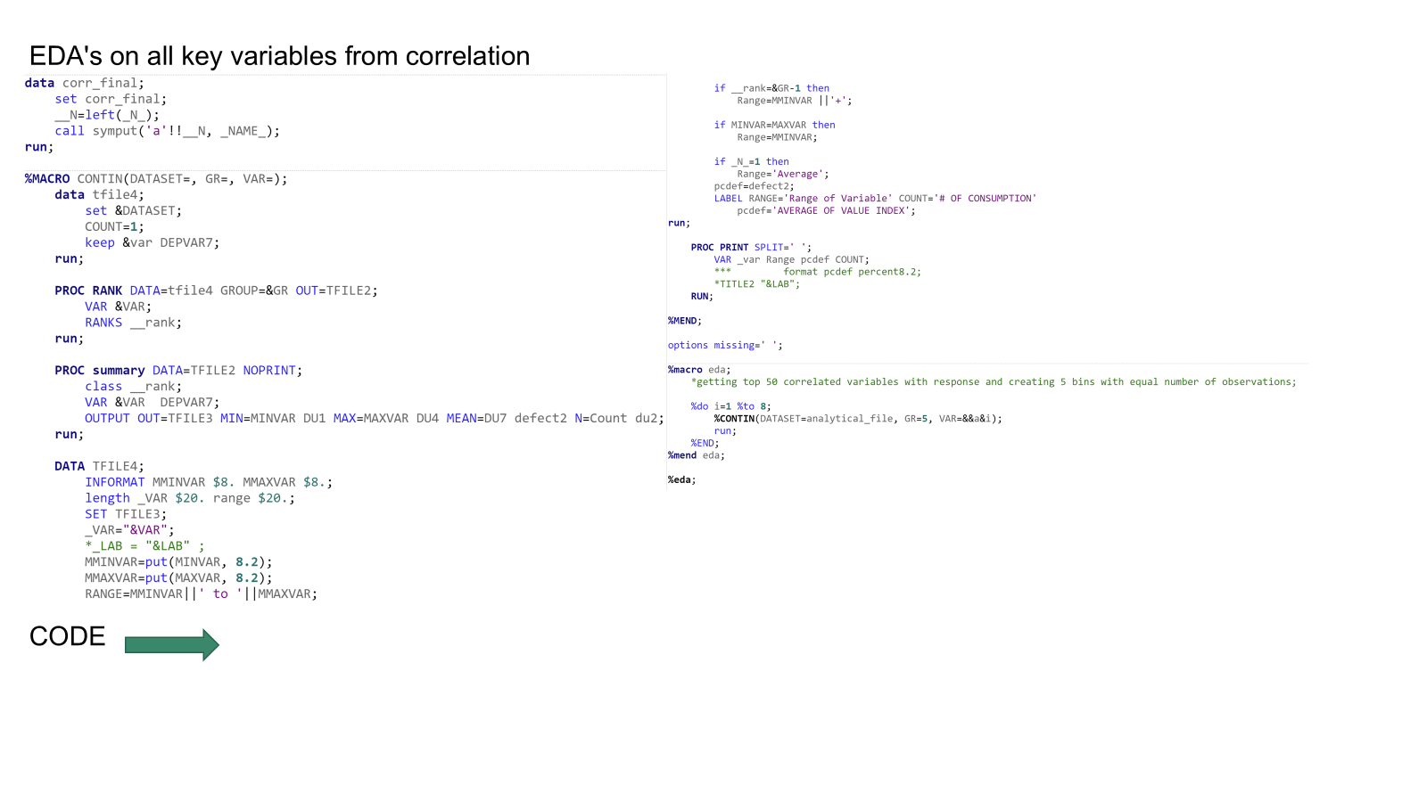

Slide 12
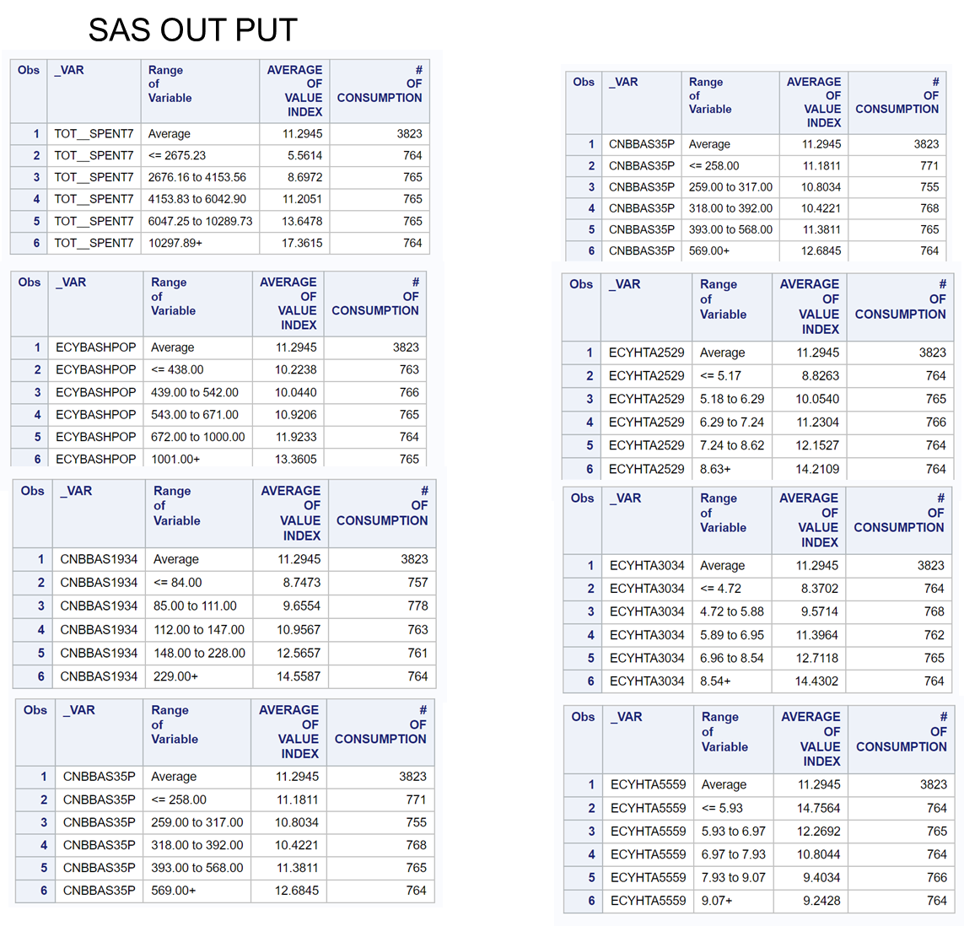

Slide 13
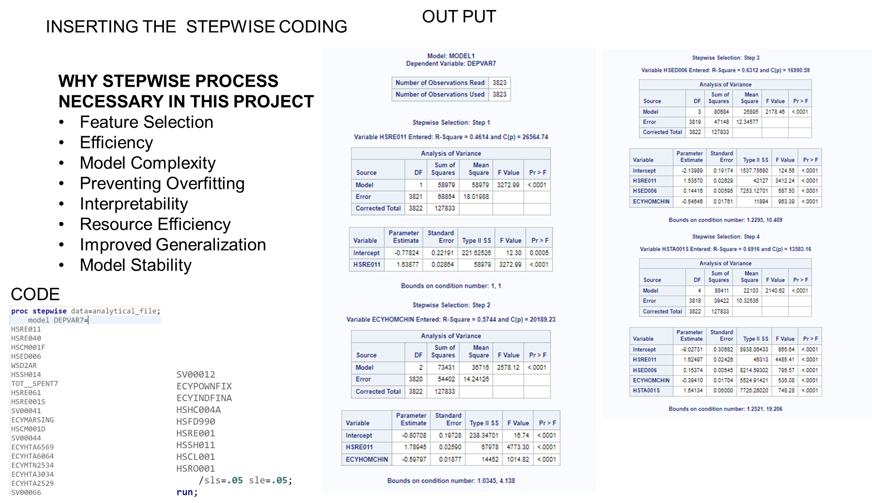
STEP 6:
Running
Stepwise regression

Slide 14
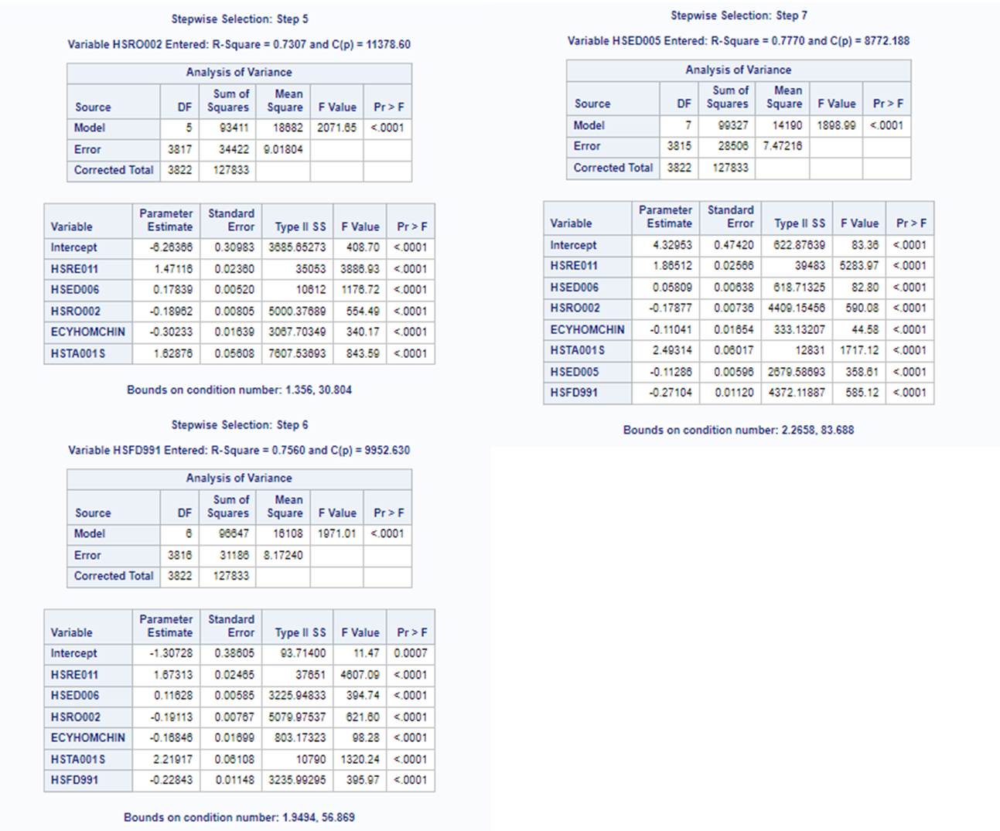

Slide 15
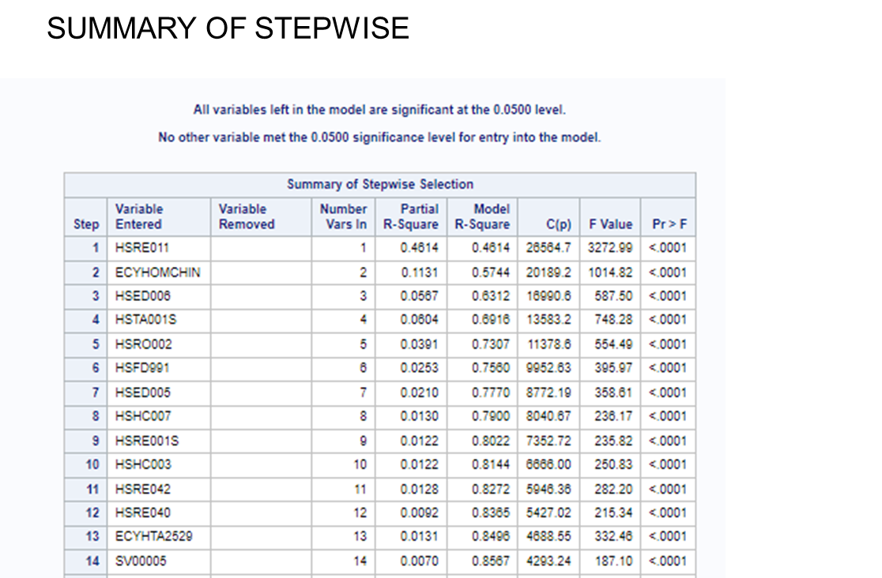

Slide 16
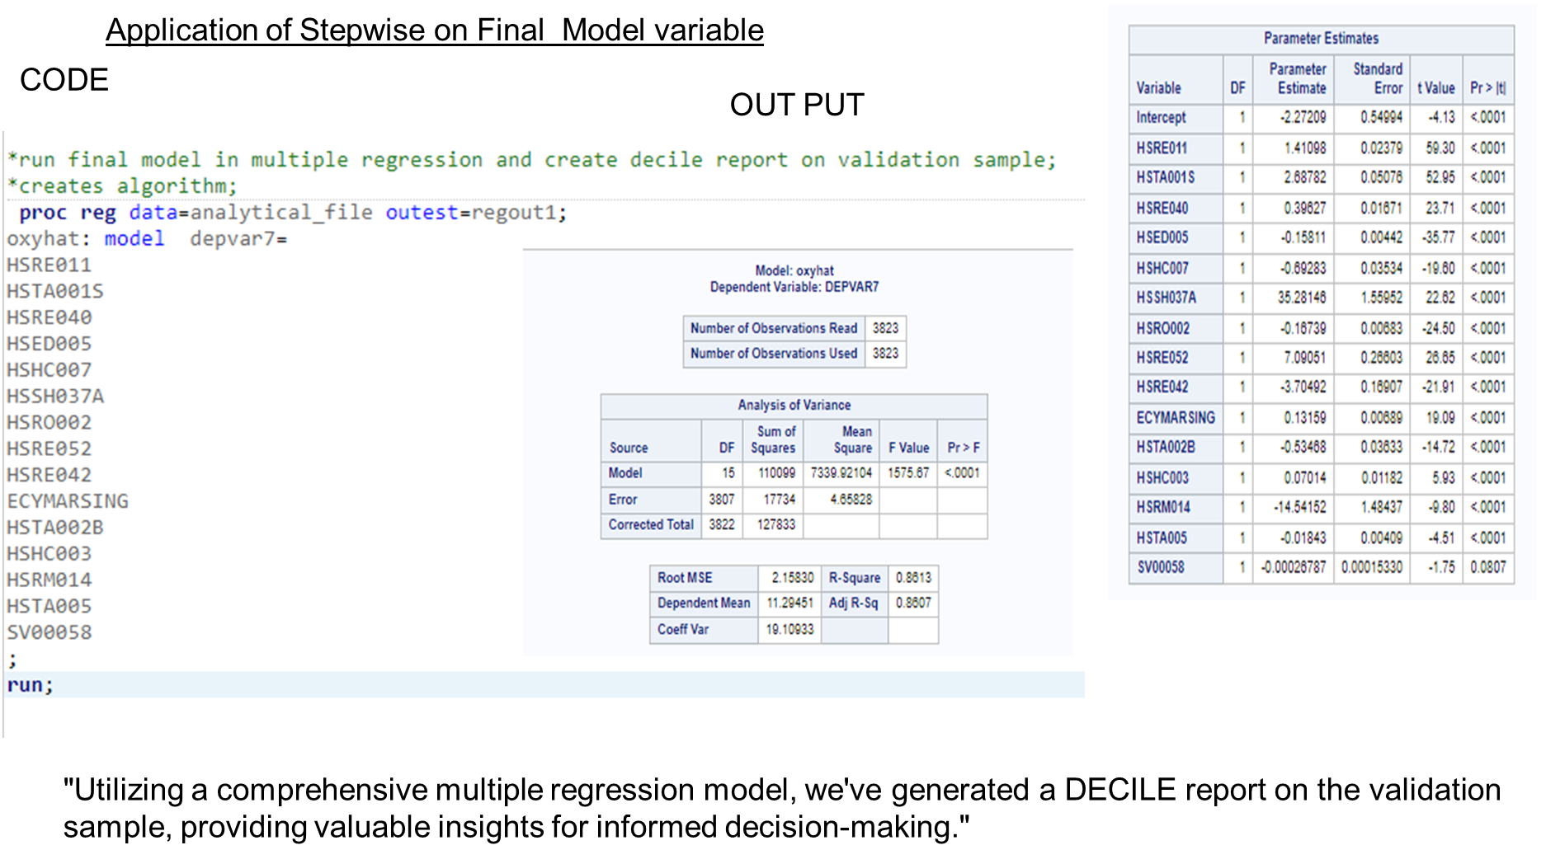

Slide 17
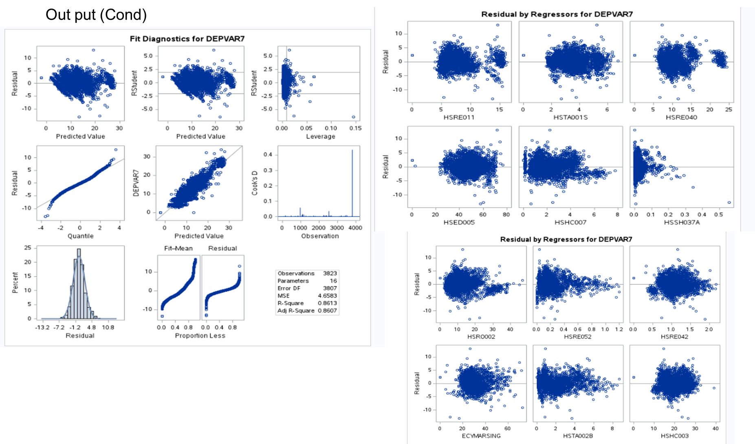

Slide 18
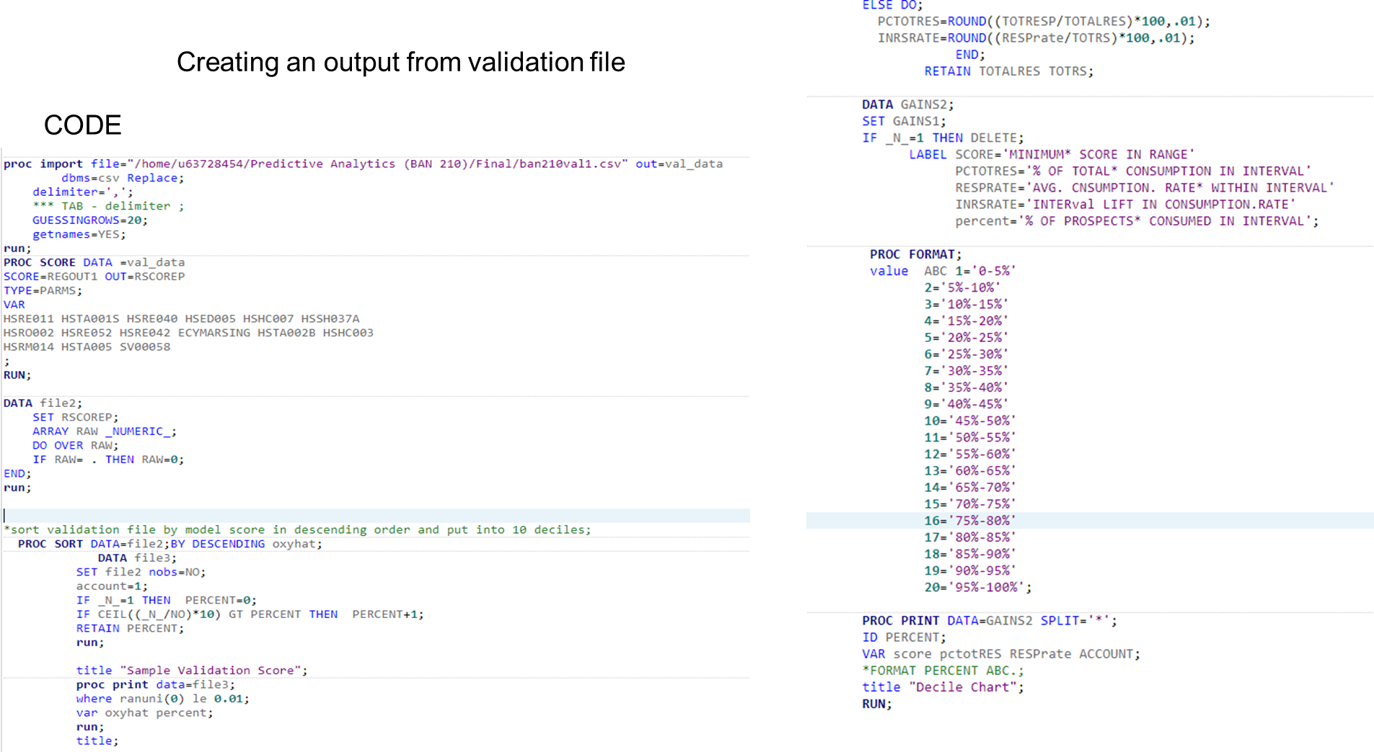
STEP 7:
Validaing model and demonstrating model performance from business perspective

Slide 19
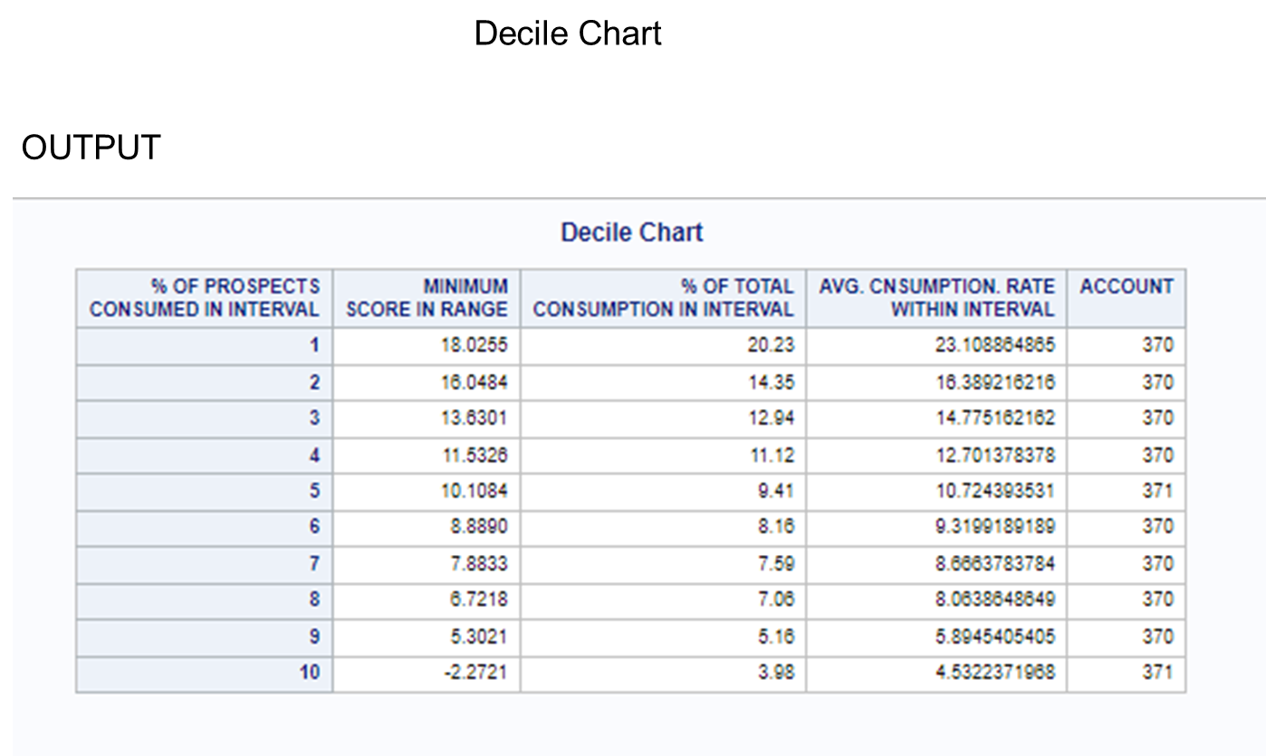
Application of Stepwise on Final Model variable

Slide 20
STEP 8:
Conclusion
Key Findings:
The decile analysis shows a clear trend where higher deciles (1-3) represent significantly higher consumption rates, indicating regions with potentially higher demand.
The highest deciles have consumption rates that are substantially above the average, pointing to market segments with the most potential.
Model Insights:
The predictive model has identified specific variables (like HSRE011, HSRM014, etc.) that are most influential in predicting areas with high consumption rates.
The use of a decision tree model (HPSPLIT) to segment the data effectively, which helps in pinpointing demographic and regional traits correlating with high consumption.

Slide 21
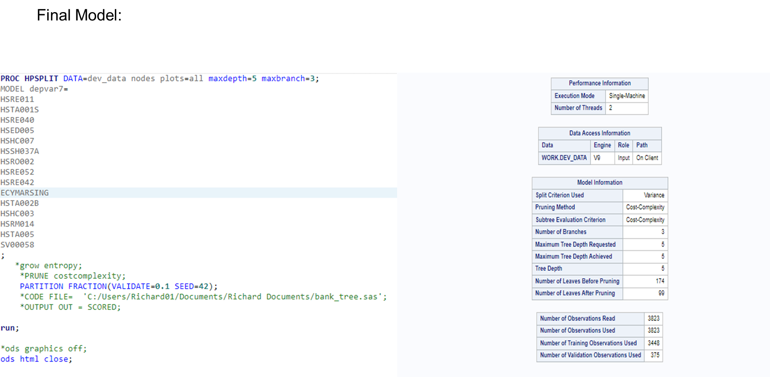
Next Step: Building a classification tree using HDSPLIT function

Slide 22
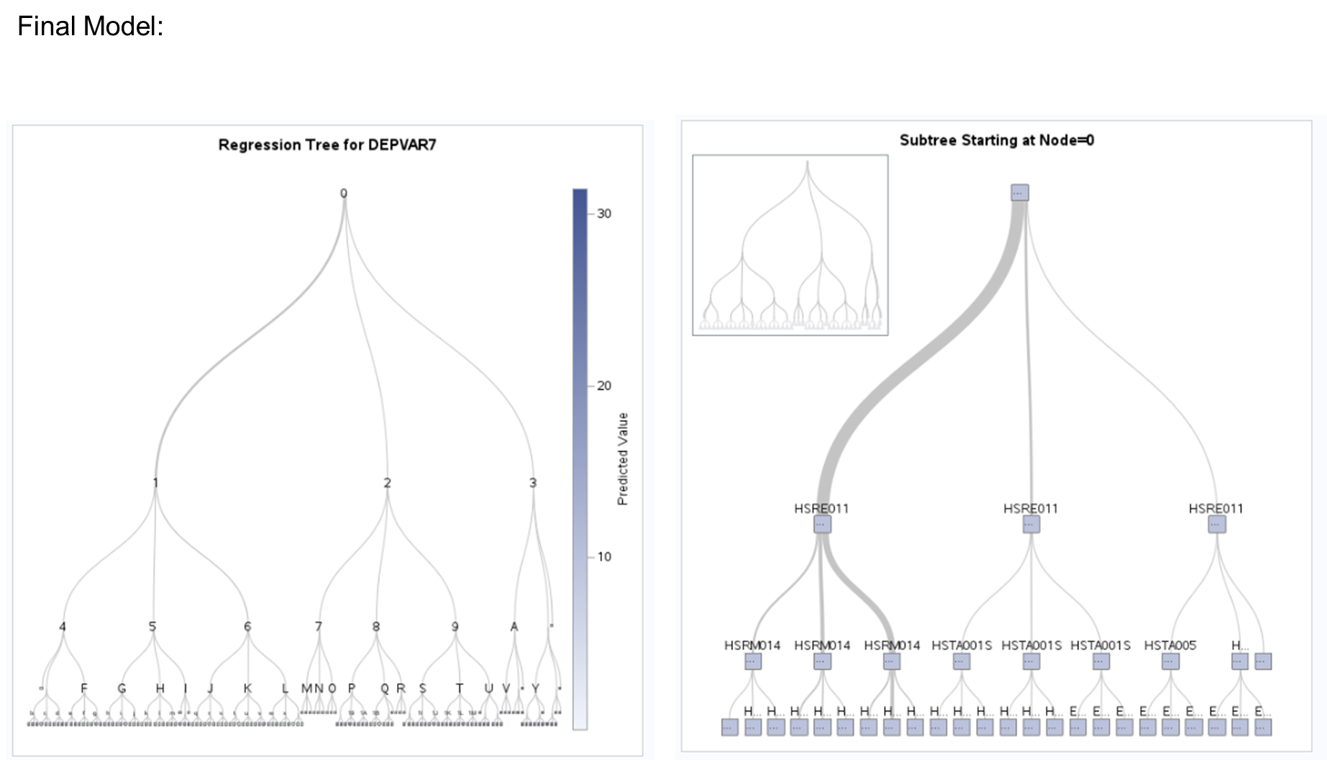

Slide 23
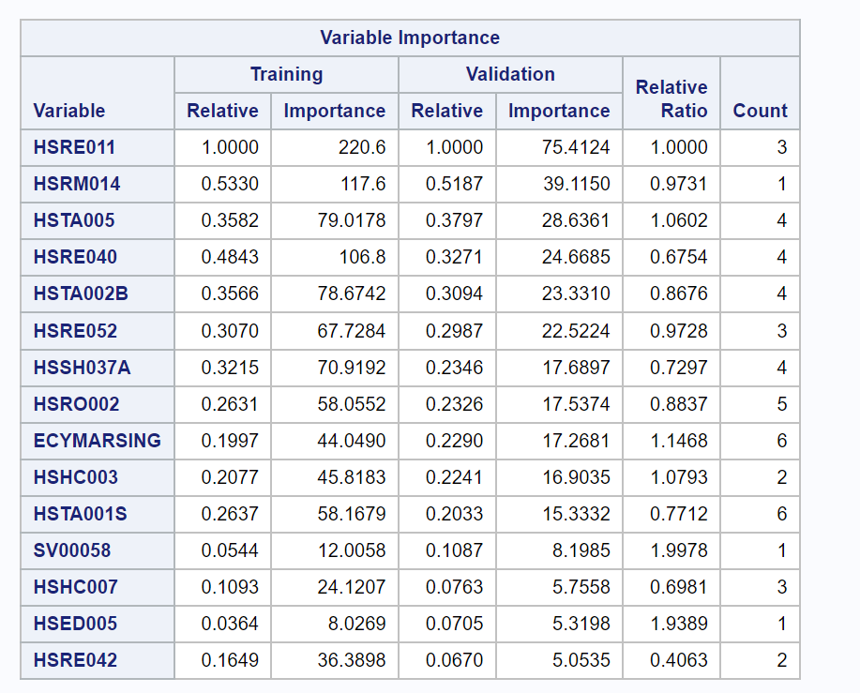
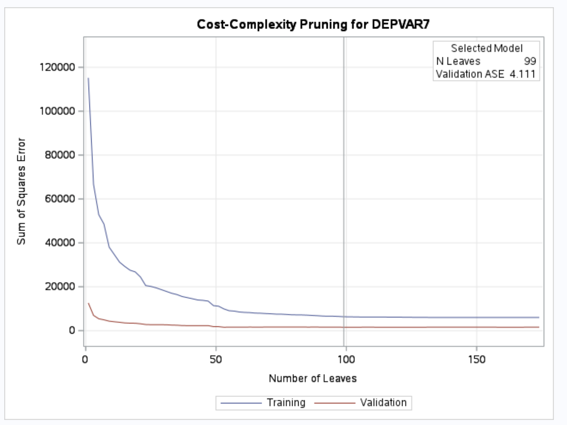

Slide 24
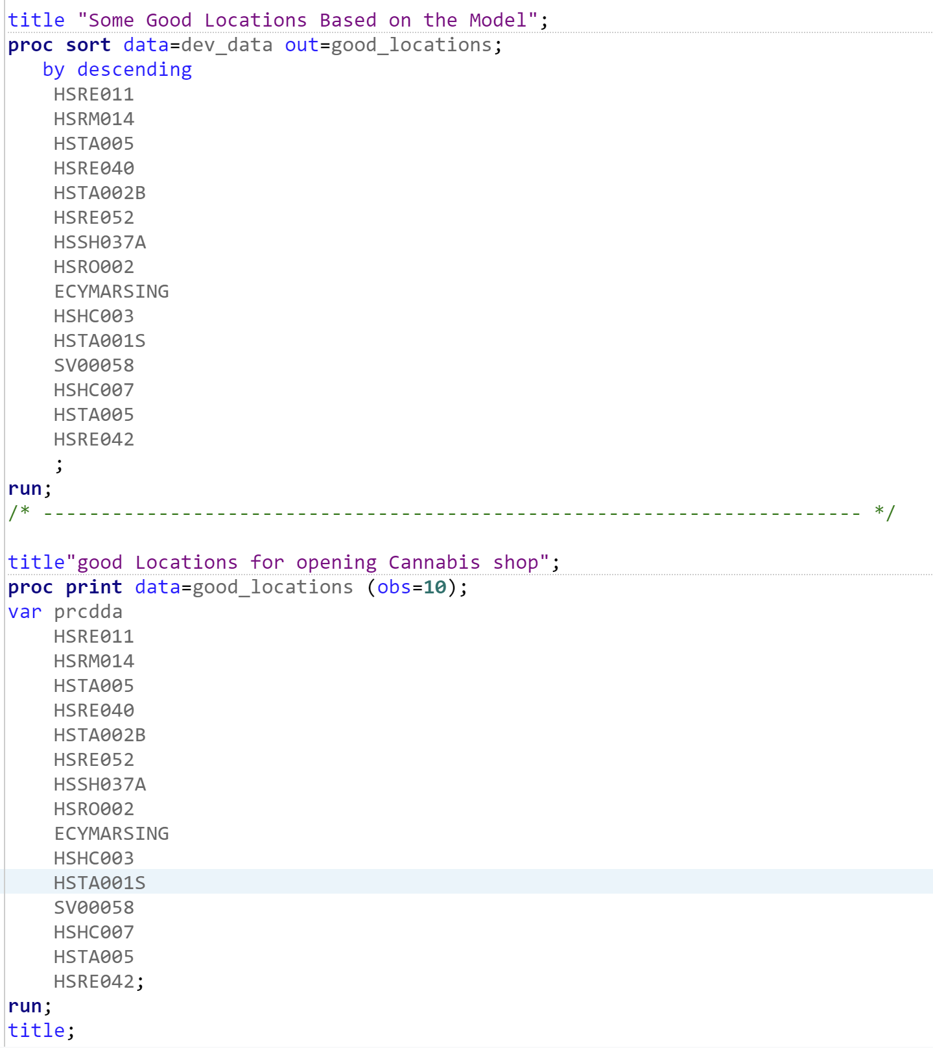
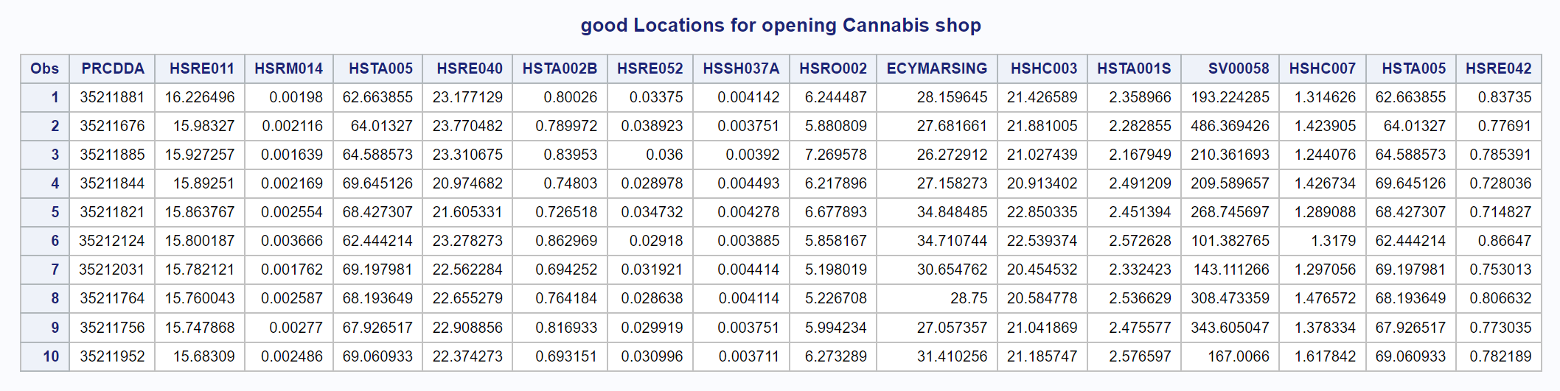
Final Output based on Decision Tree model

Slide 25
THANK YOU
10th August 2024
Group 7

